Slide 1
CS 497 Final project
May 12th, 2020

Slide 2
Project name: Gan and juice
Objective: Create a unique dataset for a Generative Adversarial Network to train on and synthesize images which are similar to that of the dataset
Creating a unique dataset
I used the website http://www.myfirstascent.com/app/routes to download images of rocks. In lieu of a brute force approach and manually downloading every image, I used a web crawler to navigate the website. In addition to the 8,379 images downloaded from the website, I also downloaded a satellite view for each rock, giving us two datasets with 8,379 images each.
Creating a Generative Adversarial Network (GAN
We create a GAN to train on our unique dataset. The GAN then learns to synthesize “fake” images which are very similar to the images from the dataset

Slide 3
TEAM
Name and Responsibilities:
Name: William Cerros
Responsibilities: Yes

Slide 4
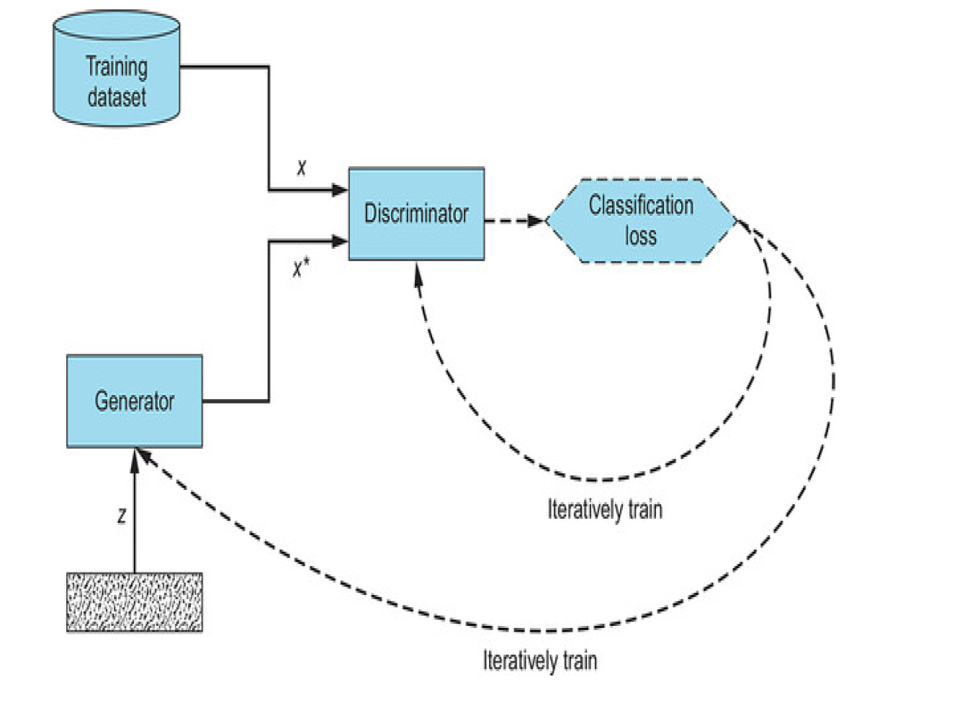
GAN overview
A Generative Adversarial Network is the act of pitting two neural network’s against each other in competition, in order to improve each model. GAN’s consist of a generator and a discriminator. Generators take a random noise vector Z as input and outputs an image. A discriminator has two inputs: images from our dataset (real images) and images generated by the generator (fakes). It outputs a score between 0 and 1 deciding whether the image is produced from the generator or from the dataset.

Slide 5
Project Summary
Objective: Create a unique dataset and then create a GAN to train on this data and synthesize images similar to that of the dataset
Part 1: Create a dataset
The first problem we are tasked with is creating a unique dataset for training. The website http://www.myfirstascent.com/app/routes is used by climbers to locate and document rocks that are climbable, these rocks are up to 50ft and higher and are located around the world. This website has 8,397 rocks documented, so I created a web crawler to navigate the website and download every image available. In addition to images from the webpage, I used the coordinates supplied for each image on the page to also download a satellite view of the rock by using google maps static api. In conclusion we have our street_view dataset with 8,397 images and satellite_view dataset with 8,397 images.
Part 2: Create a GAN
Our second task is creating a GAN to train on the datasets. We develop a generator and discriminator by implanting a Convolutional Neural Network (CNN) architecture for each. This network allows both the discriminator and generator to learn patterns that are translation invariant and with a spatial hierarchy.

Slide 6
Creating a dataset
But first a web crawler…
Since the images I need are hosted on a website, I made use of the python library Selenium to create a web crawler which could navigate the website and get to the appropriate web pages which displayed images. By inspecting the source code on each web page we are able to discern whether images are being displayed, or whether we still need to do more clicking.

Slide 7
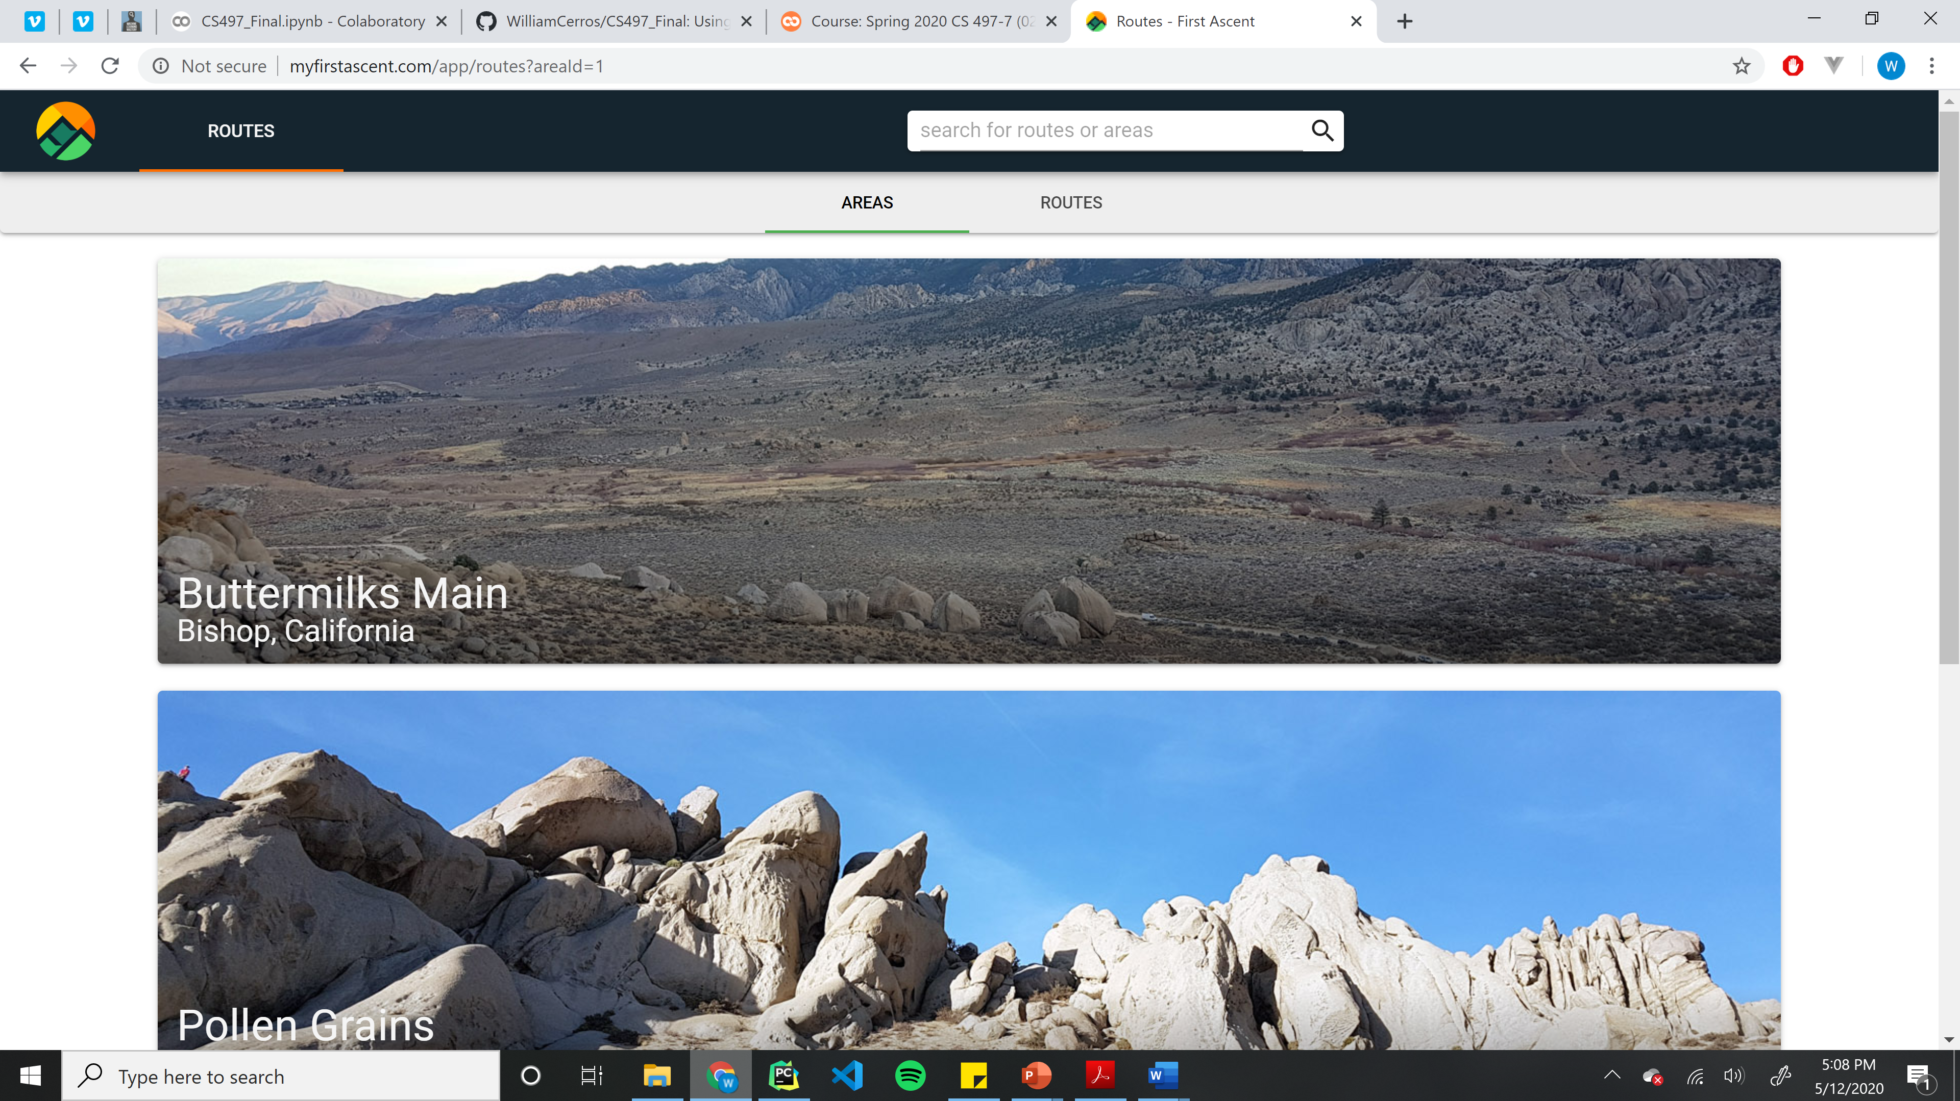
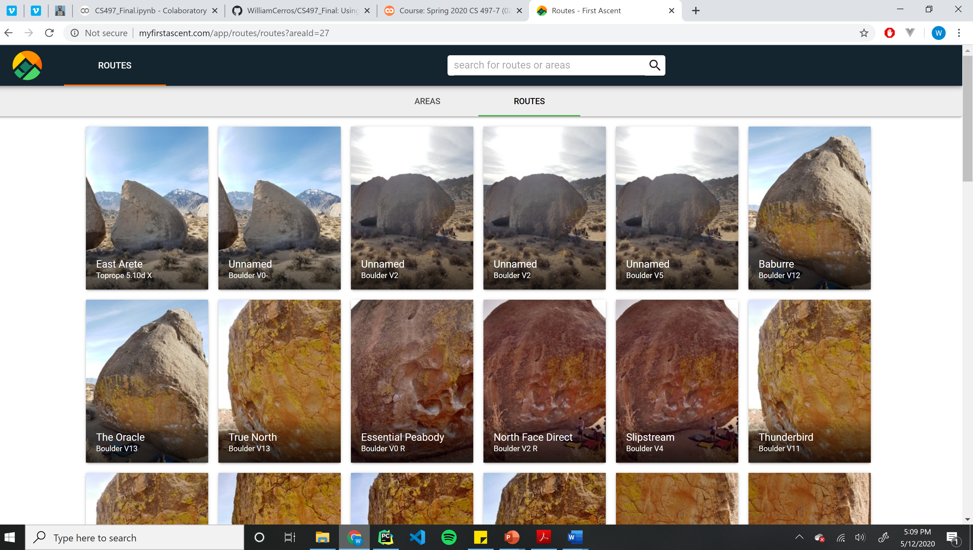
Example Web Page
Need to do more clicking
Target Destination

Slide 8
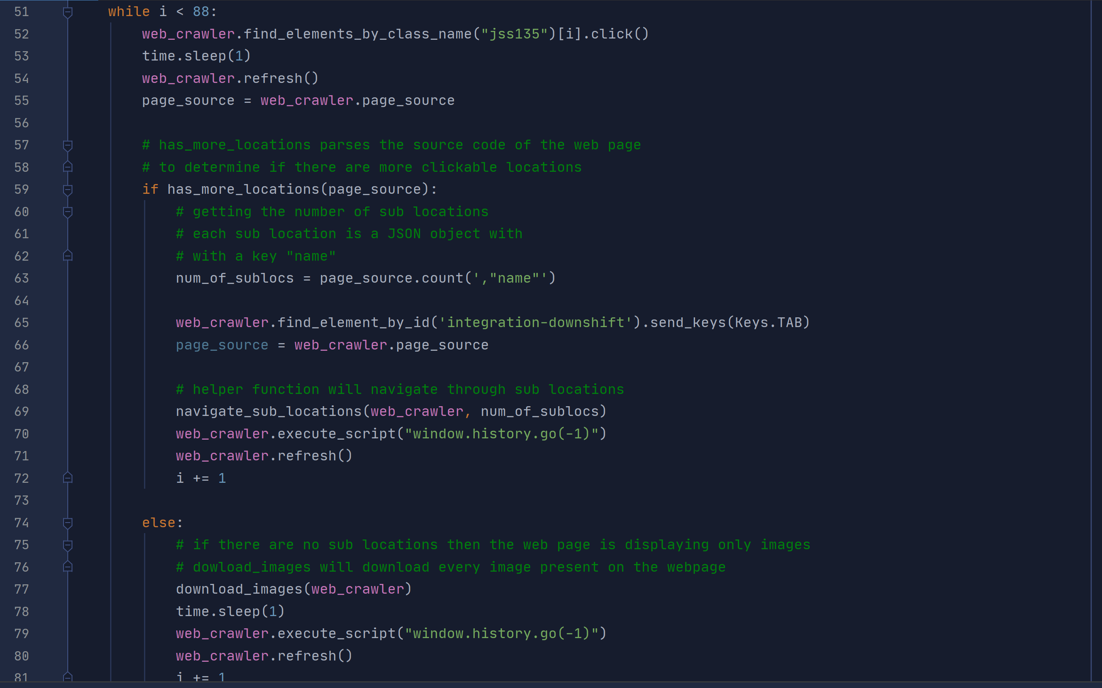
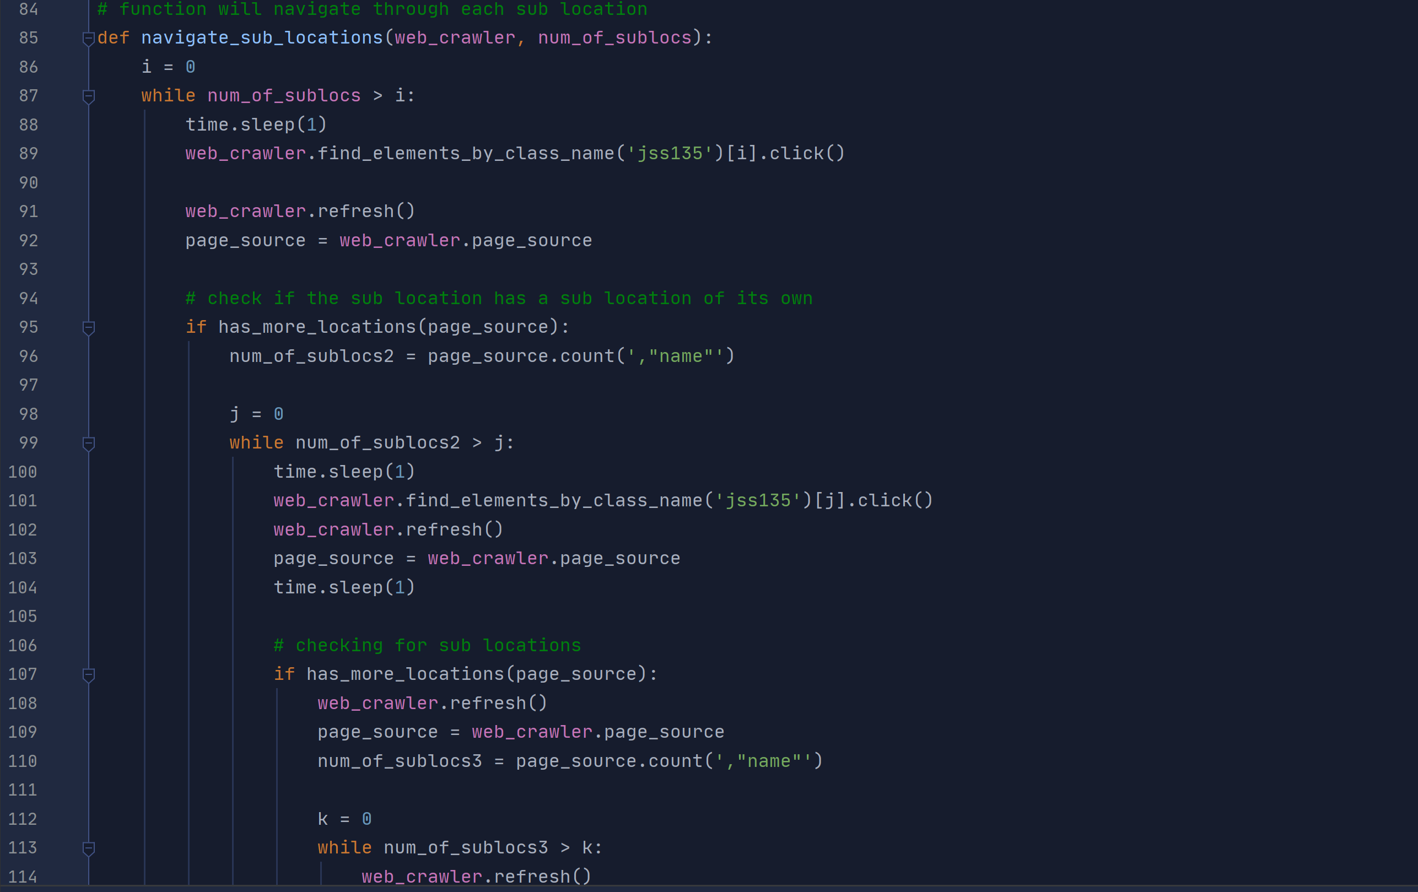
Web crawler Code

Slide 9
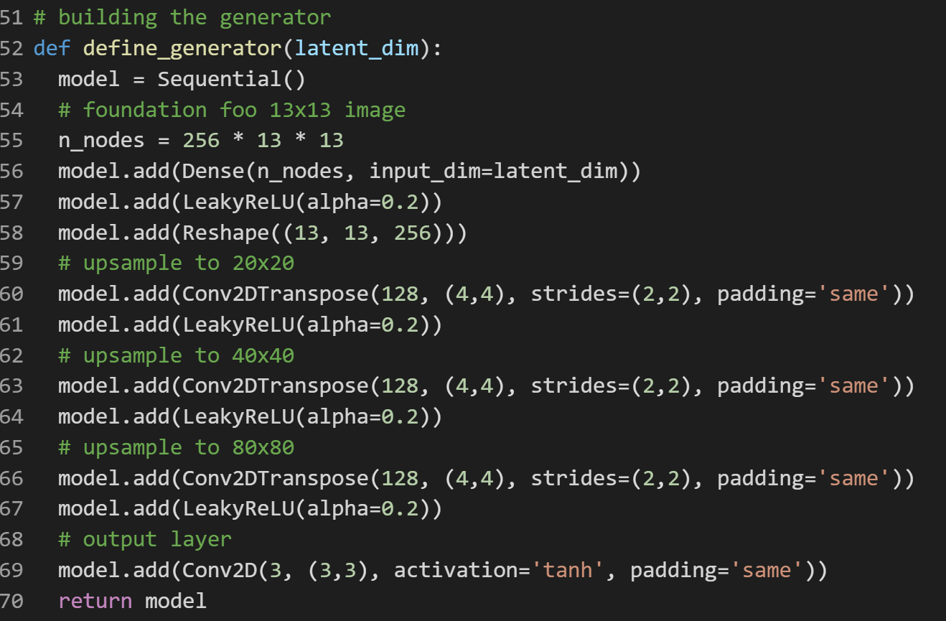
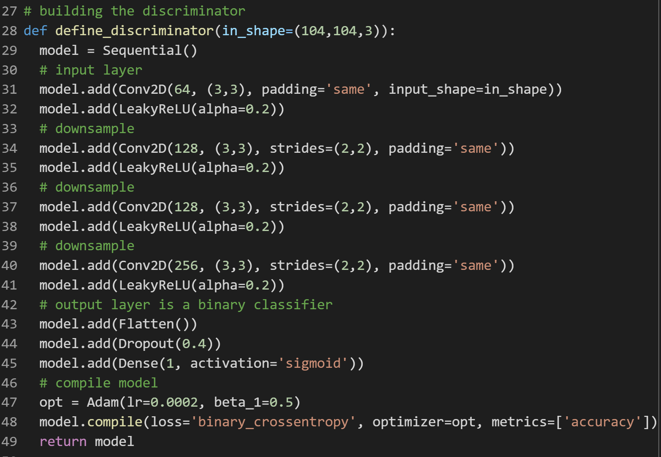
GAN Code
Generator: A Convolutional Neural Network that will output images
Discriminator: A Convolutional Neural Network that will output a binary classification score based on the image it is observing. 0 = Fake 1 = Real

Slide 10
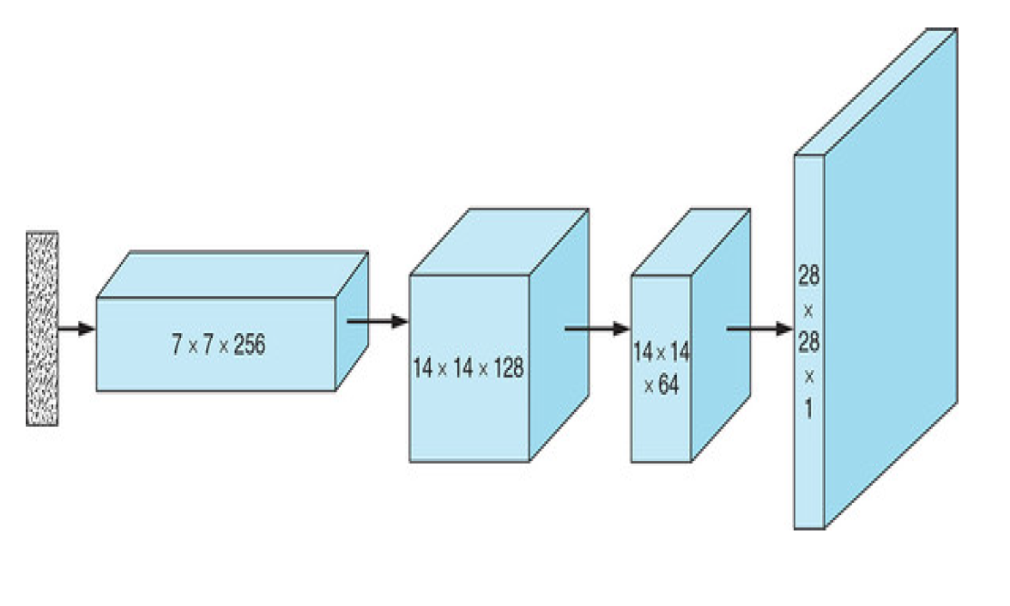
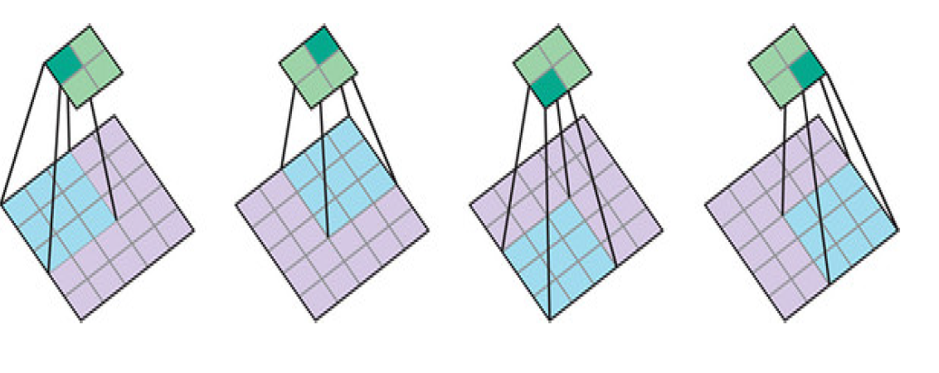
Generator and discriminator visualized
Generator: each stage represents the output of a Conv2DTranspose layer. This operation expands a 1 Dimensional vector into our 104x104x3 image
Discriminator: a classic CNN approach, we used Conv2D operation to downscale an image into a single vector which outputs whether an image is real or fake

Slide 11
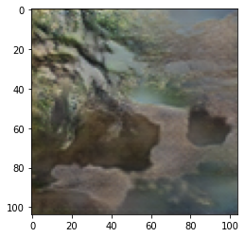
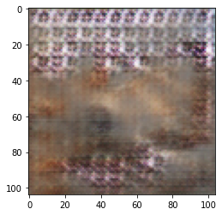
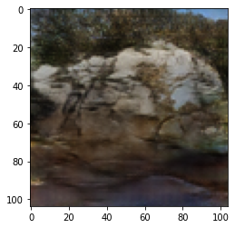
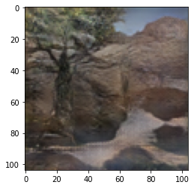
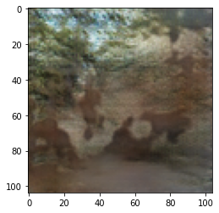
Test results
100 Epochs
Rock Images
After 10 Epochs
After 200 Epochs
50 Epochs
150 Epochs

Slide 12
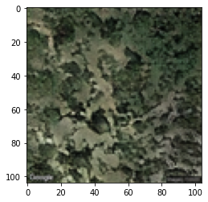
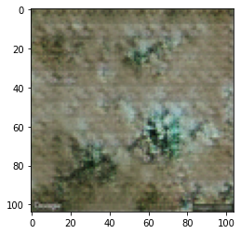
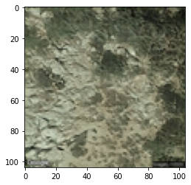
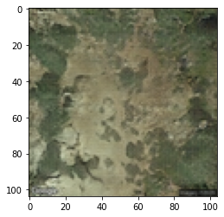
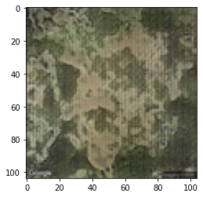
Test results
Satellite Images
After 10 Epochs
After 200 Epochs
100 Epochs
50 Epochs
150 Epochs

Slide 13
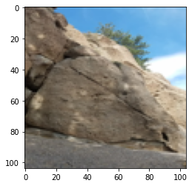
Comparing generator output with real images from dataset
Real Rock
Generated Rock

Slide 14
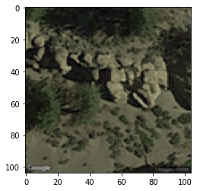
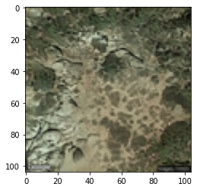
Comparing cont.
Real Satellite Image
Generated Satellite Image

Slide 15
GitHub Repo: https://github.com/WilliamCerros/CS497_Final

Slide 16
The end
Thank you!

